Slide 1
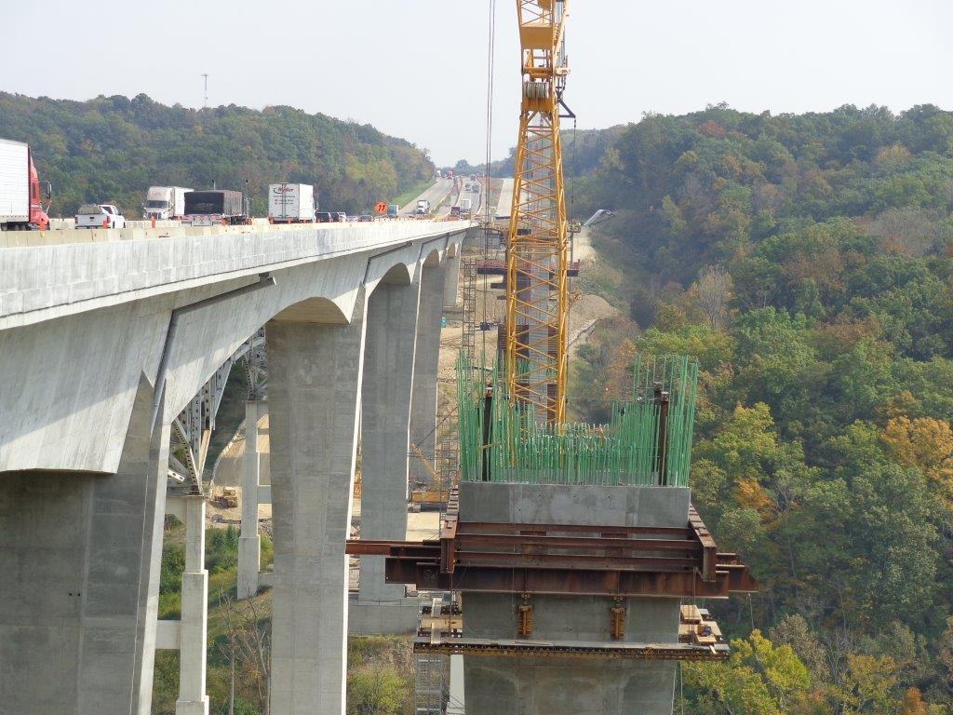
FHWA Perspective on Risk and Other Highlights

Slide 2
GROW AMERICA Proposal
Administration’s Proposal
6 Years in length
$317 billion for highways and bridges
$115 billion for transit and transportation options
More details available at
http://www.dot.gov/grow-america

Slide 3
GROW AMERICA Proposal
$140.8 billion for work on the National Highway System
$29.4 billion for the Fix-it-First Initiative
Will target structurally deficient Interstate bridges and poor pavement conditions on the National Highway System
$16 billion for the Highway Safety Improvement Program

Slide 4
DBE Final Rule
49 CFR 26.53
New Rule was effective November 3rd 2014
Major Changes to Good Faith Effort and Utilization Plan
Reporting
Notes:
Utilization Plan Timing- Must be received no later than 7 days after the letting, shortens to 5 days in 2017
Increased reporting requirements that may require additional data collection
Good Faith Efforts if the goal cannot be met must be documented prior to award of contract

Slide 5
Implementation of New Programs and Partnering
Successful Implementation requires
Clear and open communication between all involved
Appropriate Dispute resolution Processes
Clear understanding of everyone’s roles

Slide 6
Methods to Shift Risk
Changes to programs and processes
Contract Clauses
Contracting Methods
Project Practices

Slide 7
Program and Process Examples
Local Public Agency Program
Various Producer/Supplier Quality Assurance processes
Aggregates
Approved/Qualified Products Lists

Slide 8
Contract Clauses
Contractor Quality Control
Incentives and Disincentives
A+B
Lump Sum
No Excuse Bonuses

Slide 9
Contracting Methods
CMGC
Design/Build
Design/Build/Finance/Operate/Maintain

Slide 10
Risk Management
Risk management and Partnering go hand in hand
It’s very difficult to manage risk without the tools used in Partnering

Slide 11
FHWA Approach to Risk Management
Risk Based Stewardship & Oversight
Process was started in 2013
Structured around 3 areas
Project level (PoDI, PoCI)
Program level (Process Reviews, Committees, Task Forces)
Compliance Assurance Program (CAP)

Slide 12
FHWA Approach to Risk Management
Stewardship & Oversight Agreement with ODOT
Establishes roles and responsibilities
Documents requirements involving manuals, programmatic agreements, & procedures
Dispute Resolution Process

Slide 13
FHWA Approach to Risk Management
Projects of Division Interest (PoDI)
Complex and/or expensive projects
Monitoring progress and issues
Compliance Assurance Program (CAP)
Statistically based random sample
Check of program requirements
Program Level Reviews
Selected samples of projects or program elements
Detailed review of processes/program elements

Slide 14
FHWA Approach to Risk Management
Projects of Division Interest (PoDI)
Includes FHWA Major Projects
Active Construction
PoDI Projects
40 Projects $2.6 billion
ODOT Projects
970 Projects $4.9 billion

